Slide 1
Comparing Gradient Boosting Machines and XGBoost
Jack Neary

Slide 2

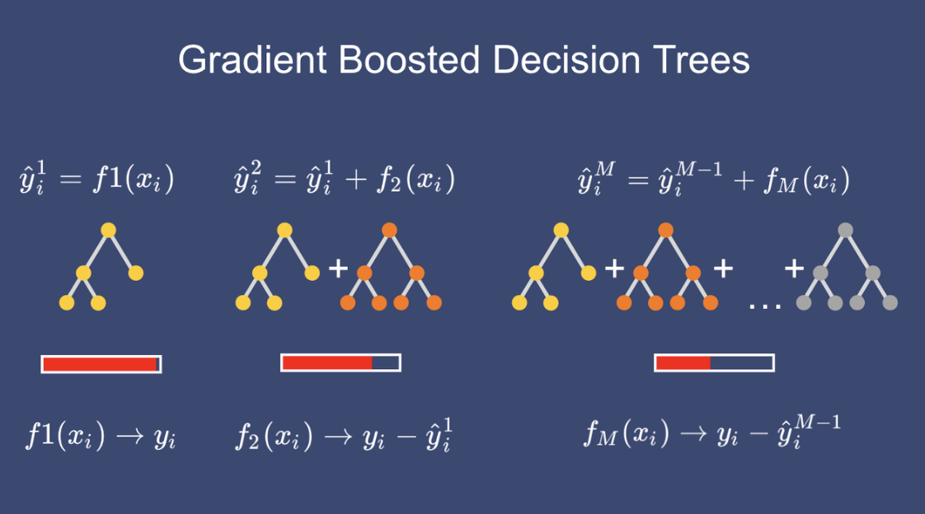
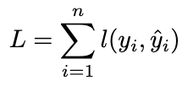
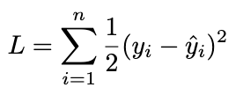
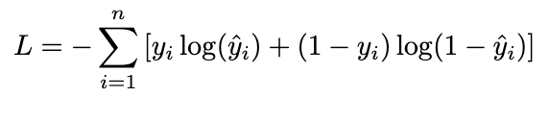
Gradient Boosting Machines (GBM)
Loss Function
https://medium.com/@abhaysingh71711/gradient-boosting-explained-turning-weak-models-into-winners-c5d145dca9ab
Notes:
GBM is an ensemble method that sequentially builds shallow trees, each correcting the errors of the previous, to minimize the loss function.
Starts with a single leaf node, usually the average value (regression) or log odds (classification)
Sequentially builds shallow trees, fitted to the residuals of the previous prediction
Scales trees with learning rate
Adds up all trees, taking small steps towards minimizing the loss function
Finding the derivative of the loss function with respect to y_hat is the gradient
Taking steps opposite of the gradient to minimize the loss is the gradient descent
In gbm, the objective function is just the loss function: for regression its minimizing the MSE, for classification its the cross entropy loss (minimizing the negative log likelihood)

Slide 3
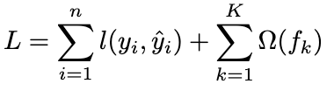
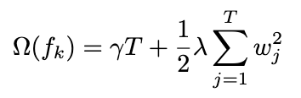
XGBoost
η x
0.5
Let’s start at the leaves!
+
η x
Ok, how does it do this???
etc…
Notes:
Also starts with a single leaf node and sequentially builds out trees to minimize the loss function using a learning rate (same as GBM!)
But also adds in a regularization term omega, that consists of regularization parameters: lambda and gamma
Gamma – penalizes large numbers of leaves (T)
Lambda – penalizes large leaf weights (w)
For both of these, like ridge regession, the higher values get higher penalties, shrinking values towards 0.
Loss function
The learning rate (eta) controls how much each tree contributes to the overall ensemble

Slide 4
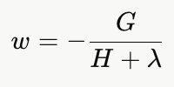
Leaf weights
Optimal prediction value for samples that land in that leaf
Calculated using gradients, hessians, and lambda
Why does the leaf weight matter?
Notes:
Rather than using just averaging the residuals, XGBoost uses both first and second derivatives, along with a regularization term, to calculate the optimal prediction value for each leaf.
This differs from GBM, which just averages the residuals in a leaf, which is the first order optimization (gradient only), gbm assumes all samples' errors are equally important regardless of confidence
Why does the leaf weight matter?
The leaf weights answer the question “what is the optimal prediction for the samples that land in this leaf?”

Slide 5
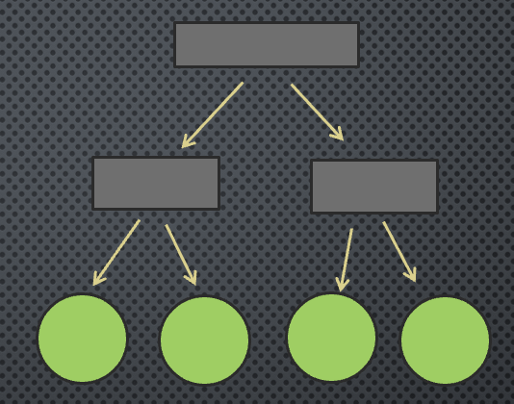


Notes:
We just saw how XGBoost calculates the optimal value FOR each leaf — but how does it decide WHERE to split in the first place?
Similarity score – measure of how pure the samples in a node are; answers the question “how good is this group of samples?”
Gain – answers the question “is this split worth making?”
Where gamma (ˠ) is is the min threshold to make the split. If the gain > gamma → keep the split, if gain < gamma → remove the split
This is called pruning! And GBM doesn’t have a sophisticated method like this to control tree complexity

Slide 6
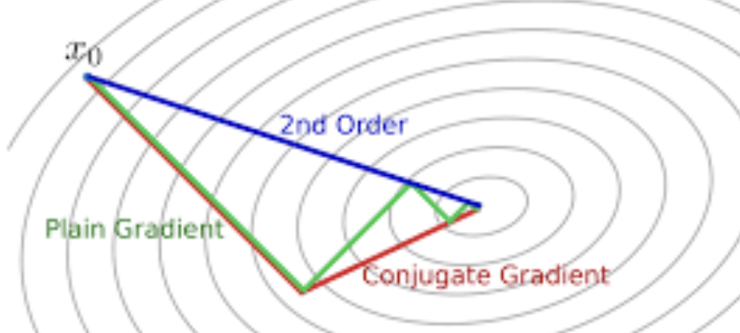
Gradients and Hessians
Notes:
With all of these formulas, G and H are the raw ingredients, but where do G and H actually come from? They’re calculated from the derivatives of the loss function!
Whereas the gradient finds the slope, the hessian understands the curvature of the terrain– enabling taking larger steps on flat surfaces and smaller steps on steep ones.
GBM has first order optimization, xgboost includes second order optimization, making it more computationally efficient, and less prone to overfitting, because the hessian is was makes lambda and gamma powerful.
Where gradient boosting answers the question “which split reduces the residuals the most?” xgboost using the second derivative answers the question “which split reduces residuals the most, weighted by our confidence in each sample's error?”

Slide 7
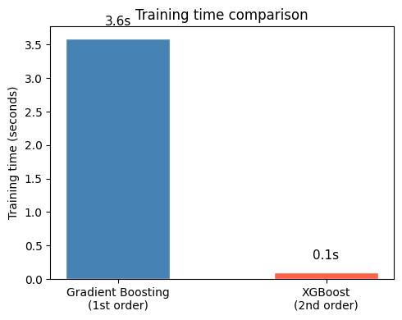
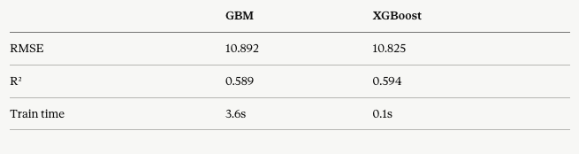
My Models
Same accuracy, 36x faster
RMSE and R^2 identical
speed from parallel split finding
Notes:
I trained 2 models to predict SBP from a dataset on Kaggle. The difference was minimal!
Sadly, for my presentation, the models were identical in predicting systolic BP.
R^2: both models explained only 60% of the variance; accuracy ceiling set by the data not the algorithm
RMSE: on average both models were off by about 10.76 mmHg
Something really cool to see is that the xgboost model trained on the data 36x faster than GBM; this is partially due to second order optimization, but also other things like parallelization (evaluating splits across features in parallel, whereas GBM does this sequentially)

Slide 8
Conclusion
XGBoost extends GBM’s core framework with second order optimization
Hessian makes lambda and gamma powerful – regularization built into the math
On 70,000 records, same accuracy 36x faster
Not always more accurate, but more efficient and scalable than GBM
Notes:
XGBoost extends GBM’s core framework with second order optimization making more precise decision every split
Scalability
At production scale — if you need to retrain on millions of patient records daily — 36x faster means hours vs minutes. Time and energy cost money, this is a more efficient method. Could save hundreds – thousands on compute prices monthly.

